Slide 1

Streak
All-in-One Product and Order Management System
Created by: Ferenc Gazdóf and Attila Gyurcsák

Slide 2

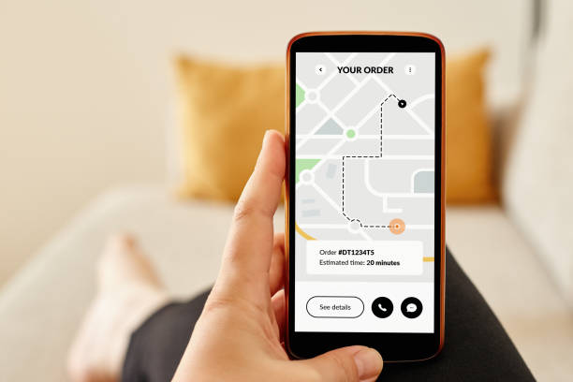
System Goal
To provide an automated and structured solution for:
Retail stores
Small and large businesses
User order tracking

Slide 3
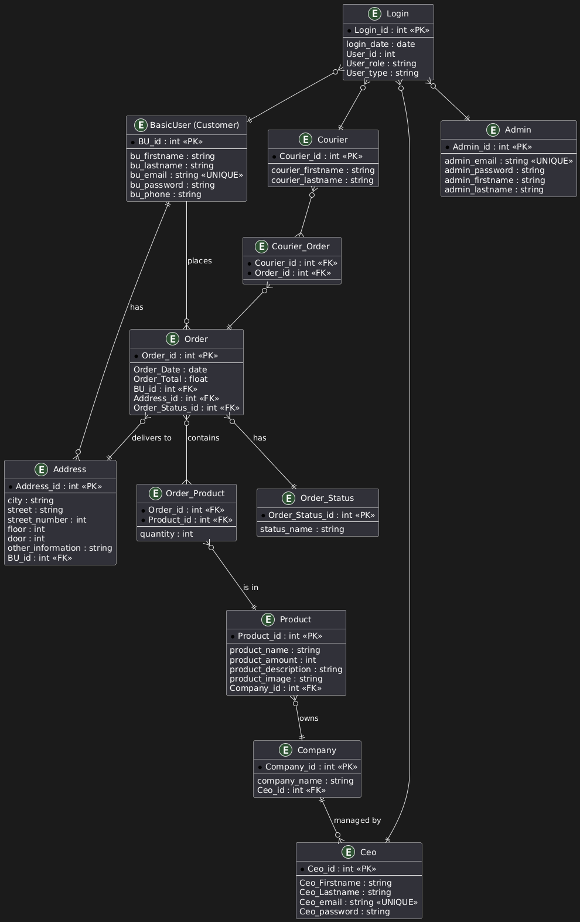
Main Features Overview
Registration and login (User, Admin, CEO, Courier)
Product management (CRUD)
Order management and status updates
Company structure management
Role-based permissions (admin, CEO, courier, customer)

Slide 4



Roles and Permissions
Administrator: System-level management
CEO: Manages company data and products
Courier: Tracks order statuses
User: Shopping, order tracking, profile management

Slide 5
User Experience
Clean, modern interface using React
UI adapts based on user role
Mobile-friendly and responsive design

Slide 6



Technology Stack
Frontend: React + CSS Modules
Backend: Spring Boot (Java)
Data Management: REST API + DTOs
Security: Role-based access, CORS configuration
Deployment: Docker + docker-compose

Slide 7

Use Cases
Launching an SME webshop with minimal IT background
Internal company order management system
Digital logistics and distribution platform

Slide 8
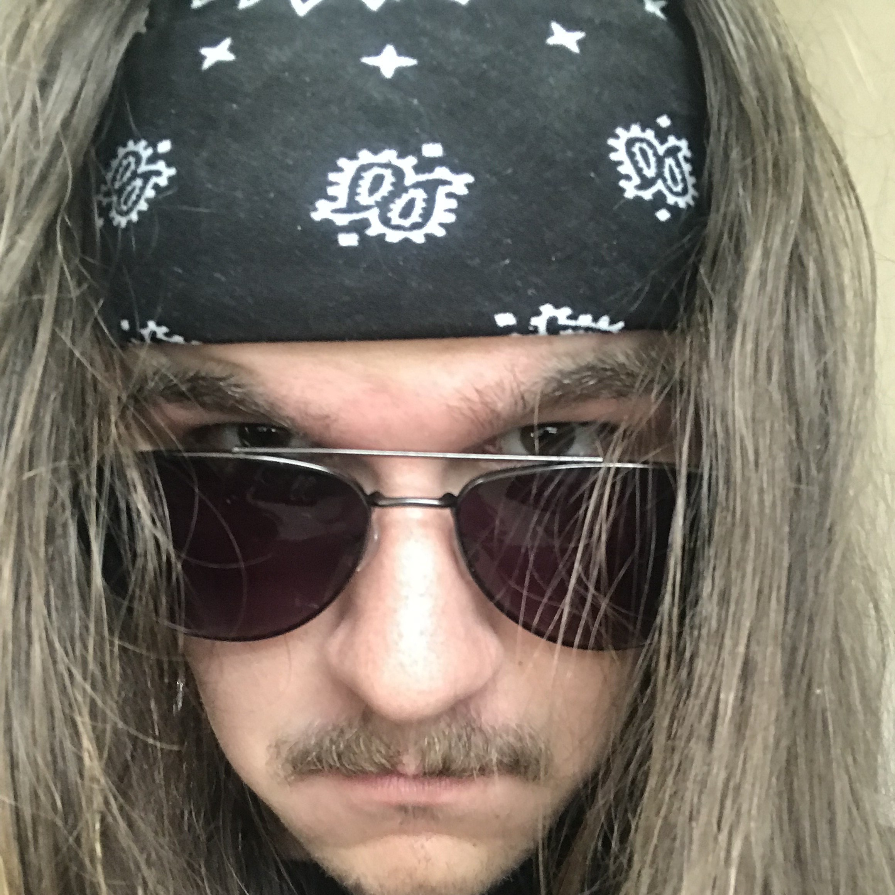

Meet the Devs
Ferenc Gazdóf
Backend
Attila Gyurcsák
Frontend and Design

Slide 9

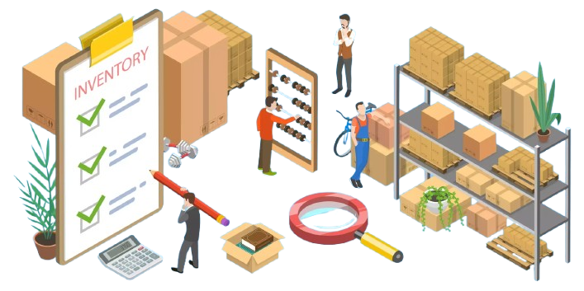
Further Possibilities / Future Developments
s
AI-based order recommendations
Inventory monitoring
Multilingual support
Analytics and reports

Slide 10
Thank you for your attention!
Presentation by: Attila Gyurcsák
Developers: Ferenc Gazdóf, Attila Gyurcsák
Links and Resources:
GitHub: https://github.com/AteezFox/projectstreak.git
Google Images: https://images.google.com/
React: https://react.dev/

Slide 11
Questions?

